Slide 1
Group meeting
2018.11.17

Slide 2
Technical report

Slide 3
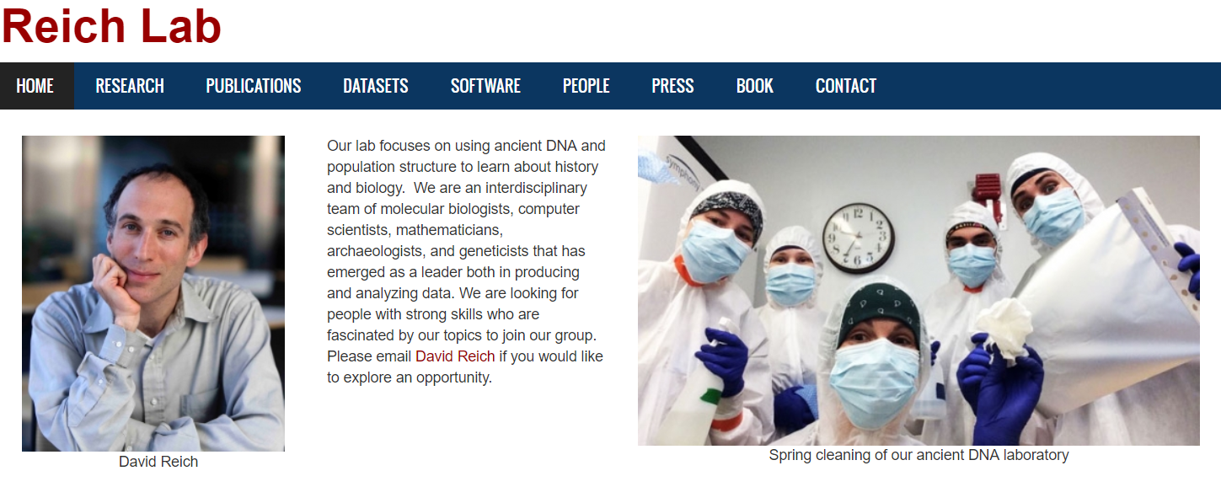
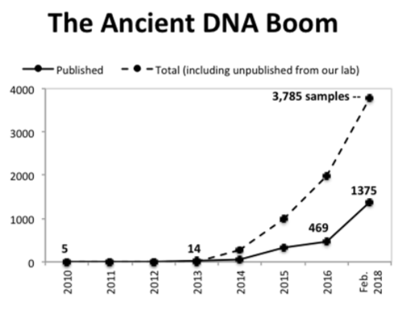
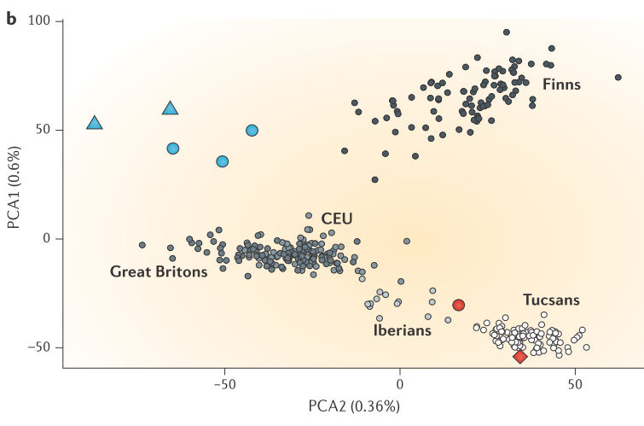
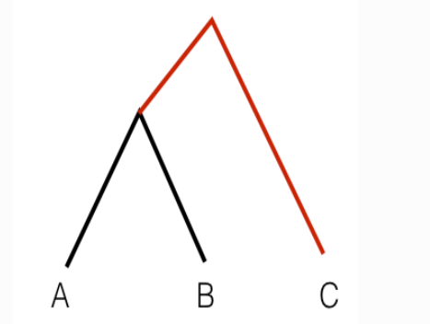
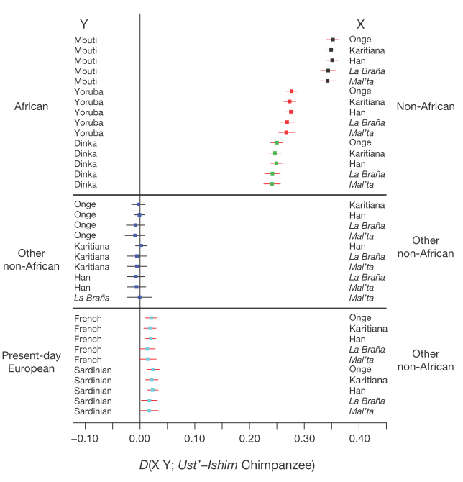
How to analysis ancient DNA
PCA
Outgroup f3 statistic
f4 statistic

Slide 4
Sequencing
degradation process has three major consequences:
low levels of DNA;
Degradation of DNA into small fragments (for example, <<100 bp);
post-mortem damage of DNA.
Shearing DNA into short fragments before second-generation sequencing is not necessary.
Endogenous DNA content is low.
Enriched for C→T substitutions at the 5ʹ end of reads, and the complementary process occurs at the 3ʹ end with G→A substitutions.

Slide 5
Fastq Quality Control
AdapterRemoval --minalignmentlength 11 --gzip --basename $out --file1 $fastq1 --file2 $fastq2 --collapse --trimqualities --trimns --minquality 15
#trimmed pairs of reads which were not collapsed
‘output_paired.pair1.truncated’; ‘output_paired.pair2.truncated’
#containing reads where one mate was discarded
‘output_paired.singleton.truncated’
#containing merged reads
‘output_paired.collapsed’
#merged reads that have been trimmed due to the --trimns or --trimqualities options
‘output_paired.collapsed.truncated’
#reads discarded due to the --minlength, --maxlength or --maxns options
‘output_paired.discarded’
‘output_paired.settings’ information on the parameters

Slide 6
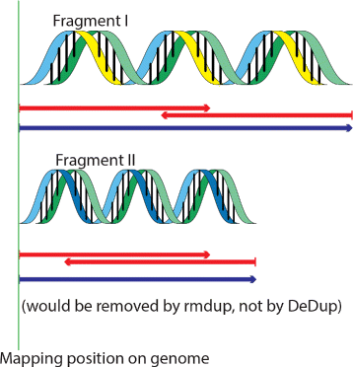
Mapping
bwa aln -l 1024 -t 4 -f $prefix.sai reference.fa $fastq
bwa samse -r '@RG\tID:'$prefix'\tLB:'$prefix'\tPL:ILLUMINA\tSM:'$prefix'' reference.fa $prefix.sai $fastq | samtools view -b -S -o $prefix.bam
samtools view -F4 -b -S -o $prefix.align.bam $prefix.bam
java -jar DeDup.jar -i $prefix.align.bam -o ./
java -jar GenomeAnalysisTK.jar -T RealignerTargetCreator -I $prefix.dup.bam -R reference.fa -o $prefix.intervals
java -jar GenomeAnalysisTK.jar -T IndelRealigner -I $prefix.dup.bam -R reference.fa -targetIntervals $prefix.intervals -o $prefix.realn.bam

Slide 7
Call Genotype
low coverage data---Called one allele at random
samtools mpileup -R -B -q20 -Q20 -l pos \
-f reference.fa \
BAM1 BAM2 | \
pileupCaller --sampleNames sample1,sample2 \
--samplePopName ancient -f loci.snp \
-m RandomCalling --seed 2018127 -o EigenStrat -e ancient

Slide 8
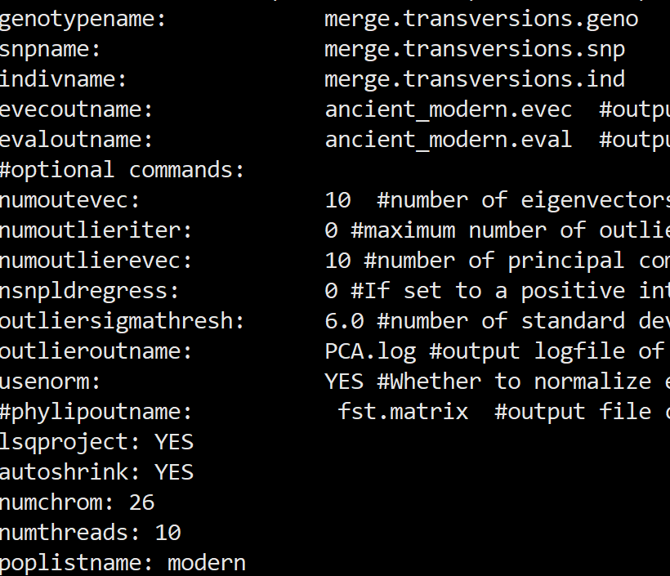
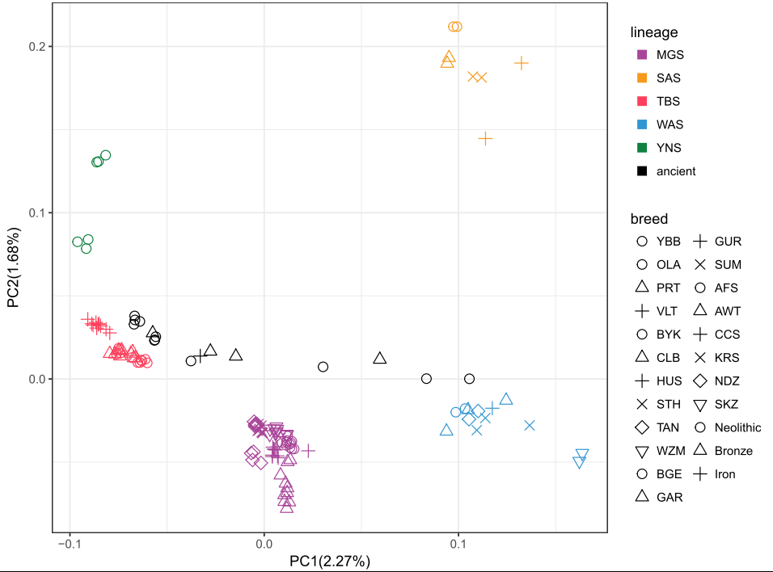
Genetic relationship
PCA
smartpca -p parameters.par

Slide 9
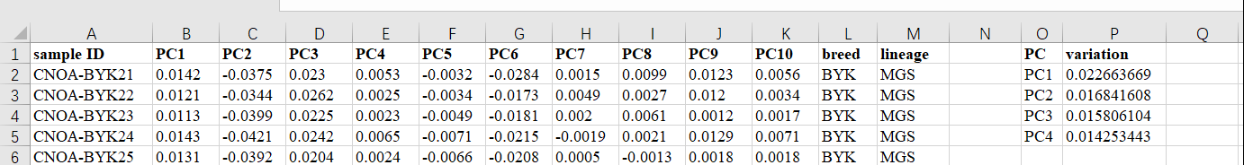
Genetic relationship
PCA plot
m_colour=c("MGS"="#A94499","SAS"="#F8991C","TBS"="#FF3F5B","WAS"="#3296D2","YNS"="#0F8140","ancient"="#000000")
m_shape=c("YBB"=1,"OLA"=1,"PRT"=2,"VLT"=3,"BYK"=1,"CLB"=2,"HUS"=3,"STH"=4,"TAN"=5,"WZM"=6,"BGE"=1,"GAR"=2,"GUR"=3,"SUM"=4,"AFS"=1,"AWT"=2,"CCS"=3,"KRS"=4,"NDZ"=5,"SKZ"=6,"Neolithic"=1,"Bronze"=2,"Iron"=3)
ggplot(data, aes(x=PC1, y=PC2, color=lineage, shape=breed)) + geom_point(size=3) + scale_color_manual(values=m_colour,breaks=c("MGS","SAS","TBS","WAS","YNS","ancient")) + scale_shape_manual(values=m_shape,breaks=c("YBB", "OLA", "PRT", "VLT", "BYK", "CLB", "HUS", "STH", "TAN", "WZM", "BGE", "GAR", "GUR", "SUM", "AFS", "AWT", "CCS", "KRS", "NDZ", "SKZ", "Neolithic", "Bronze", "Iron")) + theme_bw() + xlab("PC1(2.22%)") + ylab("PC2(1.65%)") + guides(colour = guide_legend(override.aes = list(shape = 15)))

Slide 10
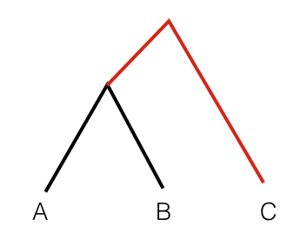
Genetic relationship
Outgroup f3 statistic
Outgroup f3 statistics measure the common branch length from the outgroup.
qp3Pop -p SM6.par >SM6.results
indivname: transversion.ind
snpname: transversion.snp
genotypename: transversion.geno
popfilename: SM6
numchrom: 26
SM6 DS4 outgroup
SM6 DS5 outgroup
SM6 DS6 outgroup
SM6 LBM5 outgroup

Slide 11
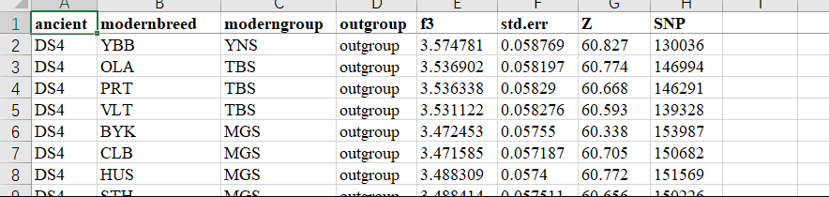
Genetic relationship
Outgroup f3 plot
m_colour=c("MGS"="#A94499","SAS"="#F8991C","TBS"="#FF3F5B","WAS"="#3296D2","YNS"="#0F8140")
m_shape=c("YBB"=1,"OLA"=1,"PRT"=2,"VLT"=3,"BYK"=1,"CLB"=2,"HUS"=3,"STH"=4,"TAN"=5,"WZM"=6,"BGE"=1,"GAR"=2,"GUR"=3,"SUM"=4,"AFS"=1,"AWT"=2,"CCS"=3,"KRS"=4,"NDZ"=5,"SKZ"=6)
ggplot(data, aes(x=modernbreed, y=f3, color=moderngroup, shape=modernbreed)) + geom_point() + facet_wrap(~ancient) + scale_x_discrete(limits = c("YBB", "OLA", "PRT", "VLT", "BYK", "CLB", "HUS", "STH", "TAN", "WZM", "BGE", "GAR", "GUR", "SUM", "AFS", "AWT", "CCS", "KRS", "NDZ", "SKZ")) + scale_color_manual(values=m_colour,breaks=c("MGS","SAS","TBS","WAS","YNS")) + scale_shape_manual(values=m_shape,breaks=c("YBB", "OLA", "PRT", "VLT", "BYK", "CLB", "HUS", "STH", "TAN", "WZM", "BGE", "GAR", "GUR", "SUM", "AFS", "AWT", "CCS", "KRS", "NDZ", "SKZ")) + theme_bw() + theme(strip.background =element_rect(fill="grey")) + theme(axis.text.x = element_text(angle = 90, hjust = 1,vjust = 0.5)) + guides(shape=FALSE, color=FALSE) + ylab("f3(ancient,modern;outgroup)") + xlab("")

Slide 12
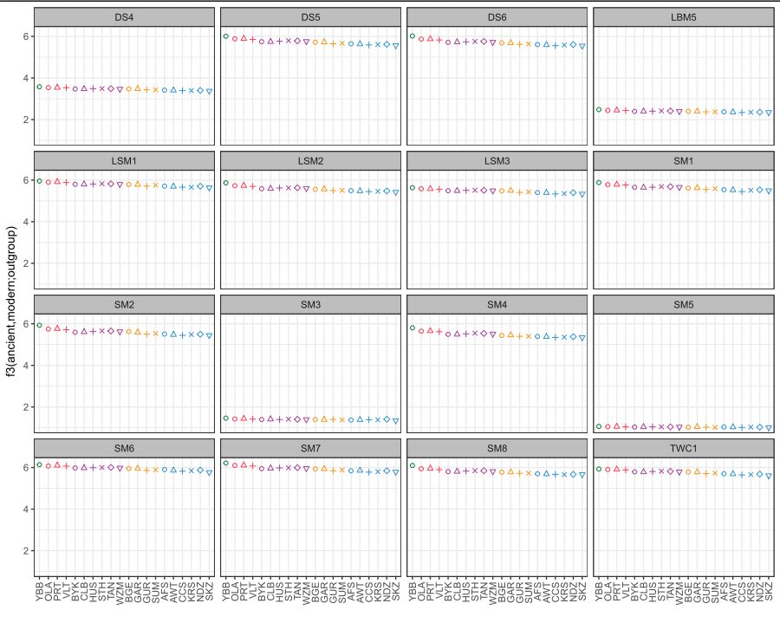
Genetic relationship
Outgroup f3 plot

Slide 13
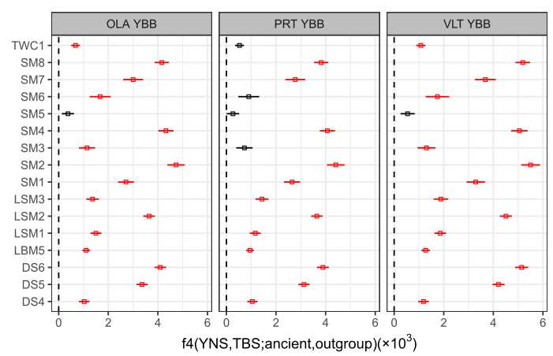
Genetic relationship
f4 statistic
f4 symmetry statistics of the form f4(outgroup, ancient; modern1, modern2) that measure a relative affinity of a pair of modern groups to ancient.
qpDstat -p SM3.par >SM3.results
indivname: transversion.ind
snpname: transversion.snp
genotypename: transversion.geno
popfilename: SM3
numchrom: 26
printsd: YES
f4mode: YES
outgroup SM3 GAR TAN
outgroup SM3 CLB KRS
outgroup SM3 AFS OLA
outgroup SM3 CLB YBB

Slide 14
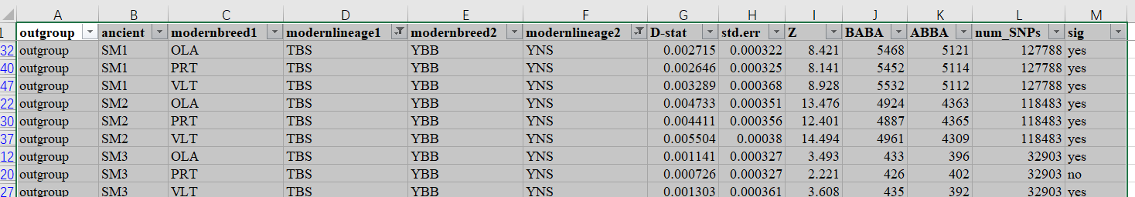
Genetic relationship
f4 statistic plot
col=c("yes"="red","no"="black")
data$max<-data$D.stat+data$std.err
data$min<-data$D.stat-data$std.err
data$labe<-paste(data$modernbreed1,data$modernbreed2,sep=" ")
p<-ggplot(data,aes(ancient,D.stat,col=sig))
p+geom_linerange(aes(ymin=min*1000,ymax=max*1000))+scale_x_discrete(limits = unique(data$ancient))+ facet_wrap(~data$labe, ncol=3) + geom_point(aes(x=ancient,y=D.stat*1000),size=1,shape=0)+coord_flip()+scale_color_manual(values=col,breaks=data$sig)+labs(x="",y=expression(paste("f4(TBS,YNS;ancient,outgroup)","(×", 10^{3},')')),title="")+geom_hline(aes(yintercept = 0),colour="black", linetype="dashed")+theme_bw() + theme(strip.background =element_rect(fill="grey"))+guides(col=FALSE)

